Slide 1



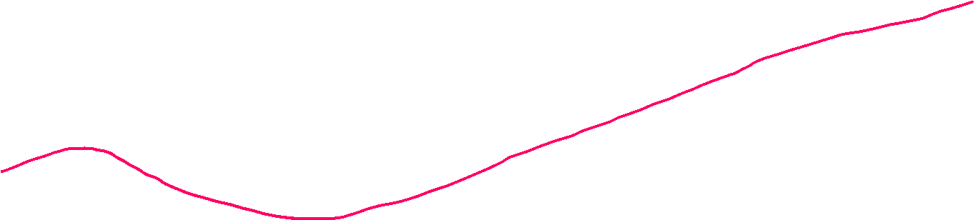
Furthering Usability and Efficiency of Massively Parallel Gaussian Process Regression as applied to Multi-Beam Sonar Data
Phillip Parisi – MS Thesis Defense
April 5th, 2023
University of Rhode Island

Slide 2
Furthering Usability and Efficiency of Massively Parallel Gaussian Process Regression as applied to Multi-Beam Sonar Data

Slide 3

Furthering Usability and Efficiency of Massively Parallel Gaussian Process Regression as applied to Multi-Beam Sonar Data
my work!

Slide 4
Furthering Usability and Efficiency of Massively Parallel Gaussian Process Regression as applied to Multi-Beam Sonar Data
existing work!

Slide 5
Furthering Usability and Efficiency of Massively Parallel Gaussian Process Regression as applied to Multi-Beam Sonar Data
better seafloor maps!

Slide 6
Furthering Usability and Efficiency of Massively Parallel Gaussian Process Regression as applied to Multi-Beam Sonar Data

Slide 7



$$y=f(x)$$
y is
dependent
x is independent

Slide 8



$$y=f(x)$$
y is
dependent
What is $f$?
x is independent

Slide 9
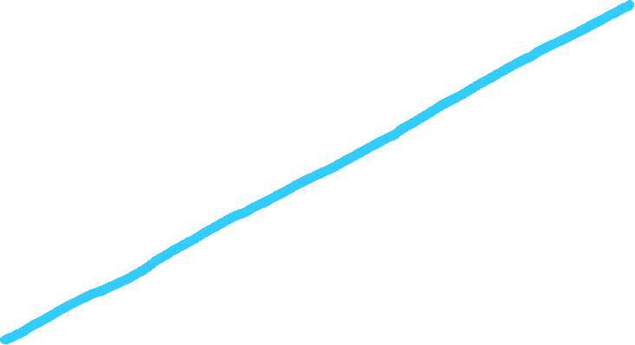
$$y=f(x)$$
y is
dependent
x is independent

Slide 10
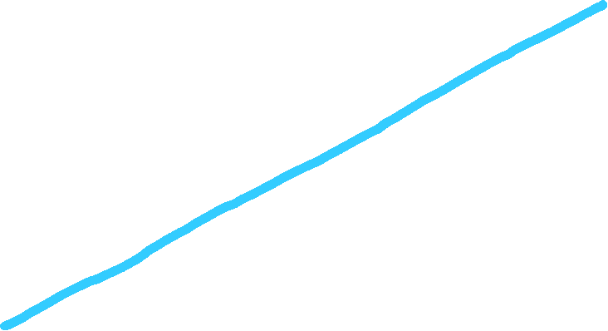

$$y=0.75x+2$$
y is
dependent
x is independent

Slide 11

parametric model
$$y=mx+b$$
y is
dependent
x is independent

Slide 12
parametric model
$$y=mx+b$$
inputs
x is independent

Slide 13
parametric model
$$y=mx+b$$
outputs
y is
dependent

Slide 14
parametric model
$$y=mx+b$$
outputs
y is
dependent

Slide 15

$$y=mx+b$$

Slide 16
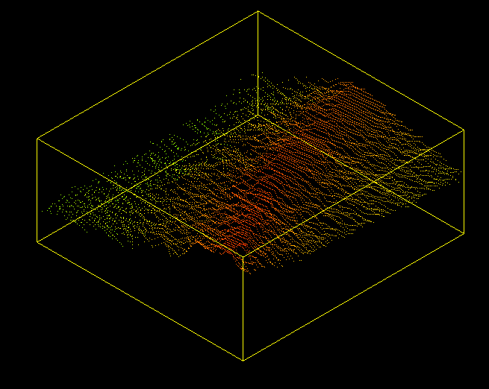




$$y= ???$$
$$y=mx+b$$

Slide 17
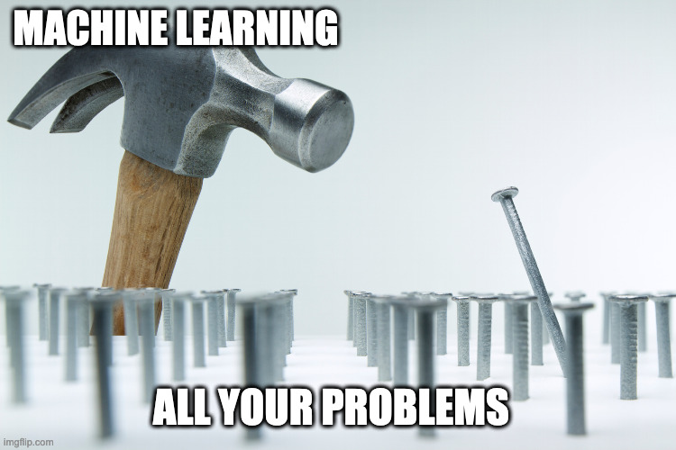



$$y= ???$$
$$y=mx+b$$

Slide 18
Furthering Usability and Efficiency of Massively Parallel Gaussian Process Regression as applied to Multi-Beam Sonar Data
machine learning!

Slide 19
Furthering Usability and Efficiency of Massively Parallel Gaussian Process Regression as applied to Multi-Beam Sonar Data
training data

Slide 20
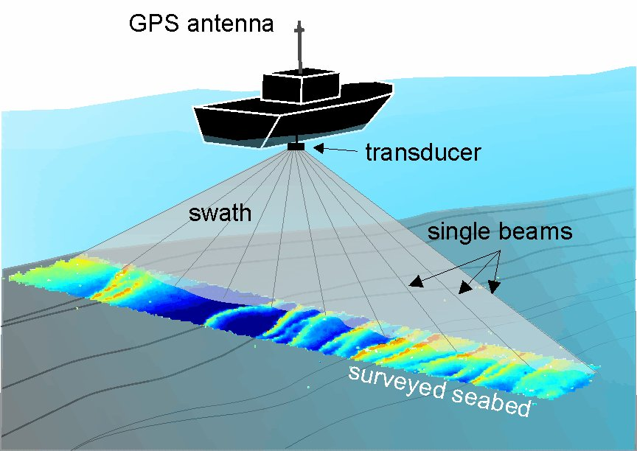
Sonar Data
latitude
depth
longitude

Slide 21
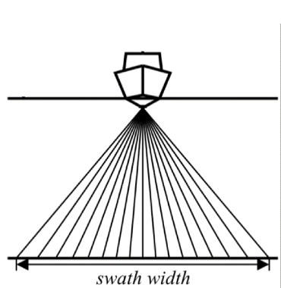
Sonar Data
ship
waterline
sonar beams
seafloor
high
uncertainty
low
uncertainty
high
uncertainty

Slide 22
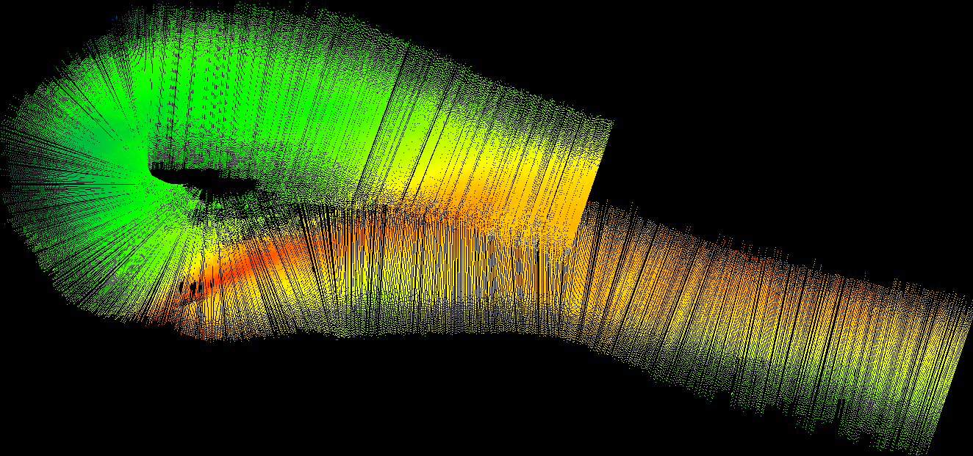
Sonar ‘Swath’
ship
ping of ~200 soundings

Slide 23
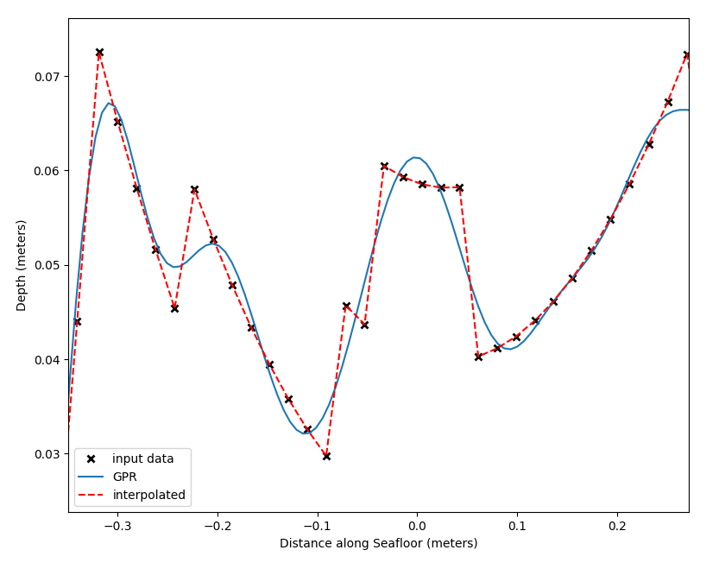

GPR on a Ping
smooth like sand
uncertainty of each
prediction

Slide 24
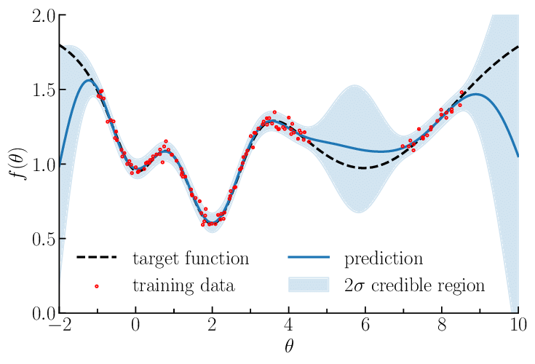
GPR on a Ping
smooth like sand
uncertainty of each
prediction
Depth (m)
Distance along seafloor (m)

Slide 25
GPR on a Ping
🤔
In robotics, we want to know where our predictions are uncertain and where they are certain!
👍
Depth (m)
Distance along seafloor (m)

Slide 26
GPR on a Ping
🤔
In robotics, we want to know where our predictions are uncertain and where they are certain!
👍
Depth (m)
Only GPR can
do this!!!
Distance along seafloor (m)

Slide 27
Furthering Usability and Efficiency of Massively Parallel Gaussian Process Regression as applied to Multi-Beam Sonar Data
how does it work?

Slide 28
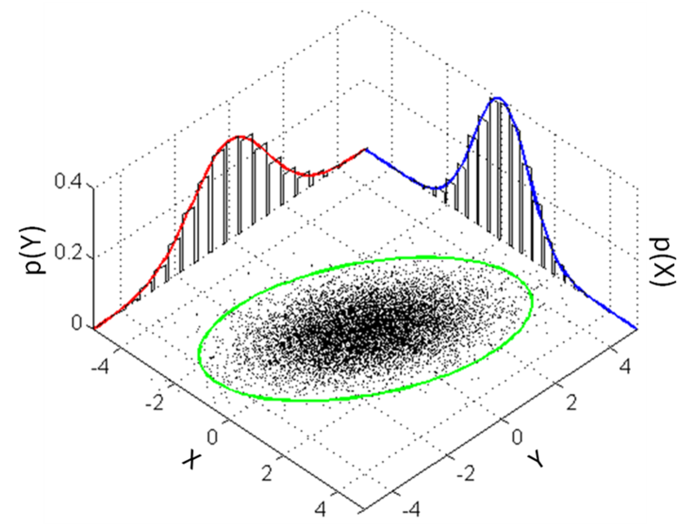
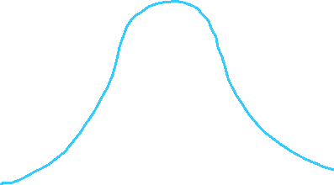











1-D Gaussian Distribution
n-D Gaussian Distribution
P(y)
P(x)

Slide 29
1-D Gaussian Distribution
n-D Gaussian Distribution
P(y)
P(x)

Slide 30

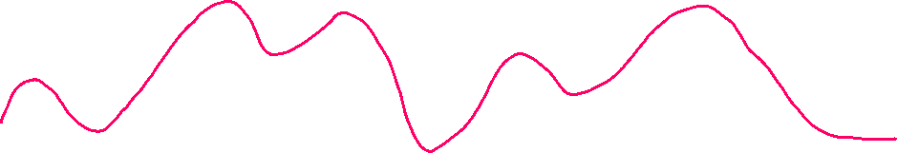
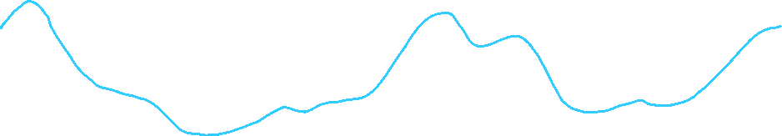
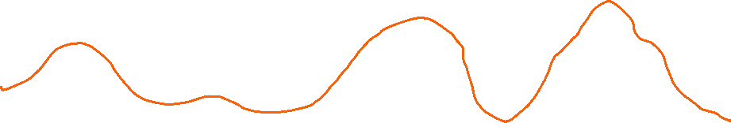
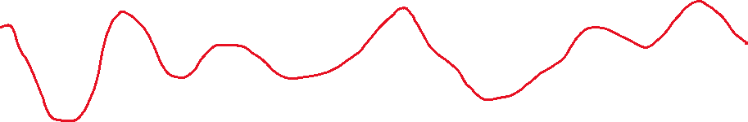
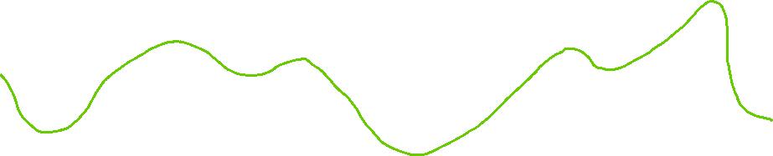
Gaussian process: collection of random variables
- any finite subset of them has a n-D gaussian distribution
- defined by a mean and covariance function

Slide 31

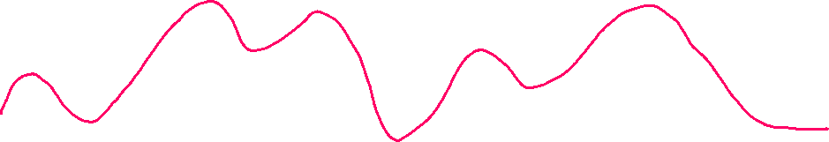
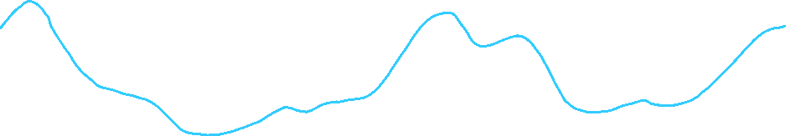



Gaussian process: collection of random variables
- any finite subset of them has a n-D gaussian distribution
- defined by a mean and covariance function
prior distribution
“no data”

Slide 32
Gaussian process: collection of random variables
- any finite subset of them has a n-D gaussian distribution
- defined by a mean and covariance function
conditioning
“using data”

Slide 33
Gaussian process: collection of random variables
- any finite subset of them has a n-D gaussian distribution
- defined by a mean and covariance function
conditioning
“using data”

Slide 34
Gaussian process: collection of random variables
- any finite subset of them has a n-D gaussian distribution
- defined by a mean and covariance function
conditioning
“using data”

Slide 35
Gaussian process: collection of random variables
- any finite subset of them has a n-D gaussian distribution
- defined by a mean and covariance function
conditioning
“using data”

Slide 36
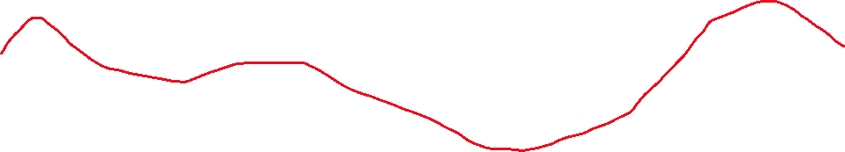
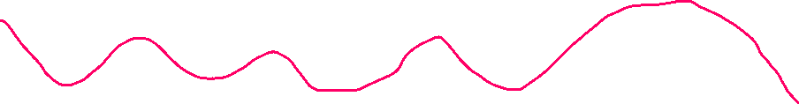
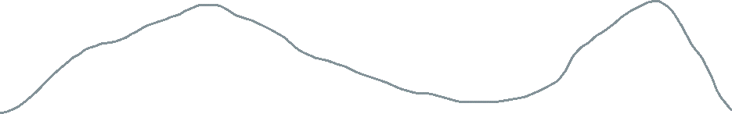
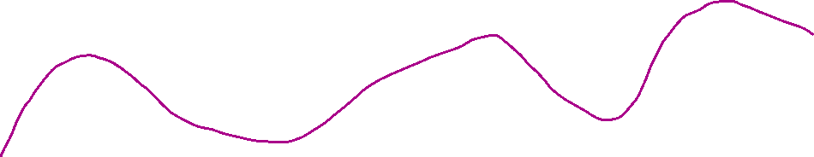
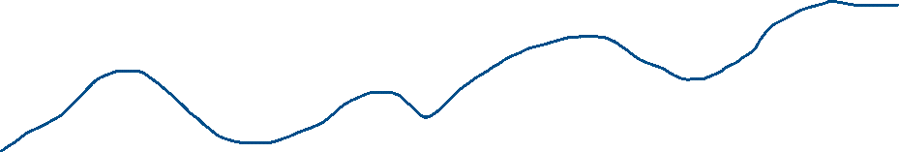
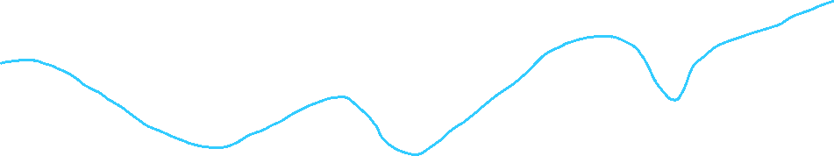
Gaussian process: collection of random variables
- any finite subset of them has a n-D gaussian distribution
- defined by a mean and covariance function
infinite variables

Slide 37

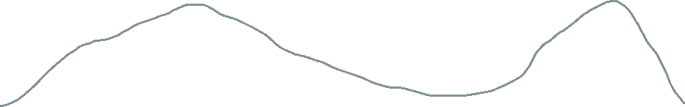

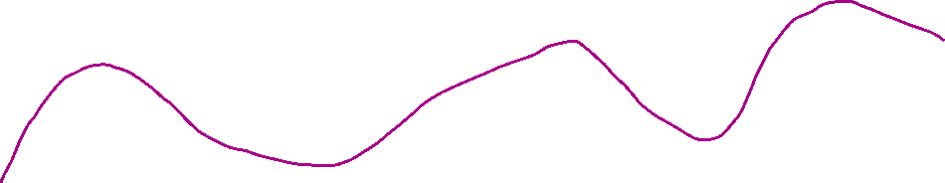
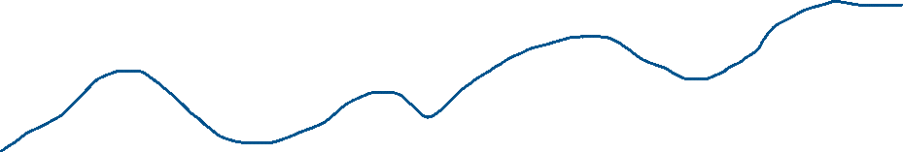




Gaussian process: collection of random variables
- any finite subset of them has a n-D gaussian distribution
- defined by a mean and covariance function
means and
variances

Slide 38



Gaussian process: collection of random variables
- any finite subset of them has a n-D gaussian distribution
- defined by a mean and covariance function
posterior distribution

Slide 39
Gaussian process: collection of random variables
- any finite subset of them has a n-D gaussian distribution
- defined by a mean and covariance function
posterior distribution
Depth (m)
Distance along seafloor (m)

Slide 40
Why don’t we all just use GPR for everything?
smooth predictions
uncertainty of each prediction

Slide 41



Why don’t we all just use GPR for everything?
smooth predictions
$$O(N^{3})$$
uncertainty of each prediction
slow
$$O(N)$$
Linear regression is

Slide 42
Furthering Usability and Efficiency of Massively Parallel Gaussian Process Regression as applied to Multi-Beam Sonar Data
make GPR faster!

Slide 43
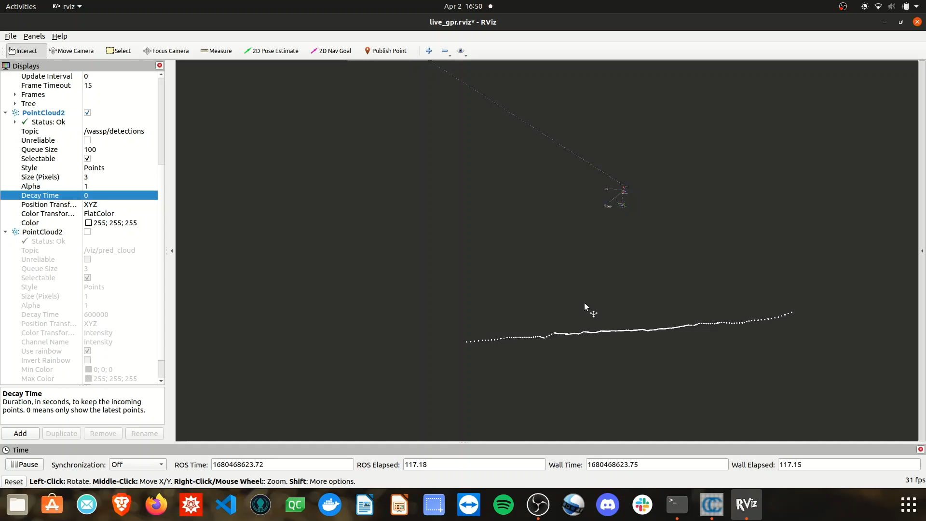
Questions
What errors to present?
What time metric to present?
Other open advice from committee

Slide 44
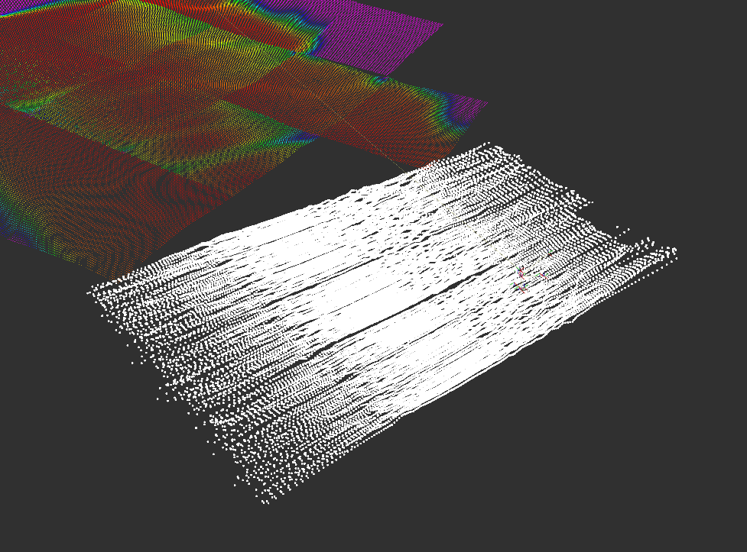
Massively Parallel Gaussian Process Regression
GPR model
pre-trained
live data
(pings)
prediction
tiles

Slide 45

Pings
Swath
$$labeled data$$

Slide 46
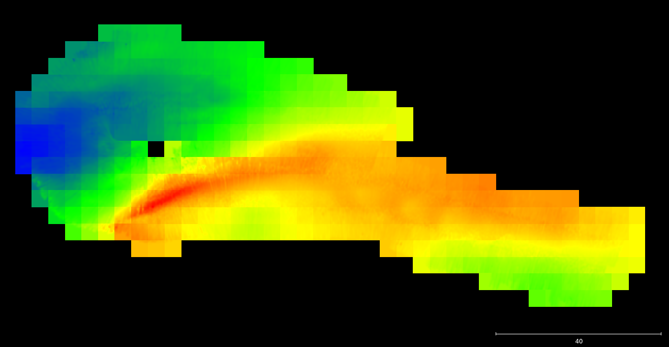
MP-GPR Flow
Tiles
$$predictions at new dense points$$

Slide 47
Massively Parallel Gaussian Process Regression
real-time updatable GPR solution
exact solution (uses all data)
number of computational speed-ups
runs on a GPU

Slide 48
Massively Parallel Gaussian Process Regression
requires heavy-duty GPU
constant sonar uncertainty
not as fast as it could be

Slide 49
Furthering Usability and Efficiency of Massively Parallel Gaussian Process Regression as applied to Multi-Beam Sonar Data
my work!

Slide 50

Let’s downsample!
What if…
We choose the ‘best’ M points from N?
$$O({20}^{3})$$

Slide 51

Let’s downsample!
What if…
We choose the ‘best’ M points from N?
$$O(5^{3})$$

Slide 52



Let’s downsample!
as we use fewer points…
…the algo speeds up…
…and accuracy goes down.

Slide 53
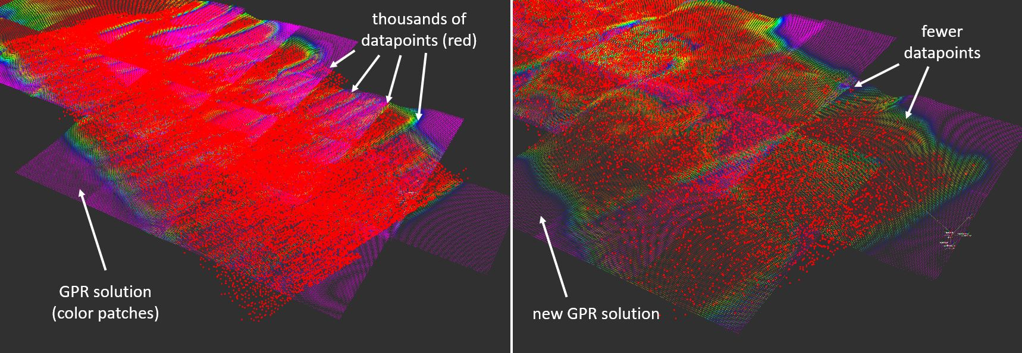
All datapoints (exact solution)
10% of datapoints (approximate solution)

Slide 54



The Crux
$$\min_{ time}{ }$$
$${\max_{acurracy}{ }}$$
$$({\operatorname{MPGPR}{) }}$$
over each method and downsample percent

Slide 55
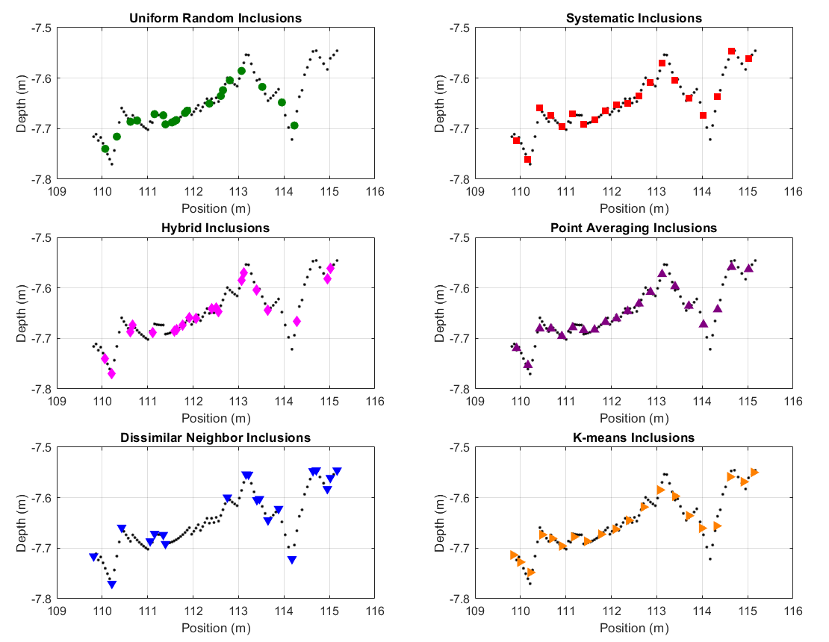
6
Methods
100 pts → 20 pts

Slide 56


Exact
100%
$$150m wide x 60m tall$$
$$330,000 pts$$

Slide 57
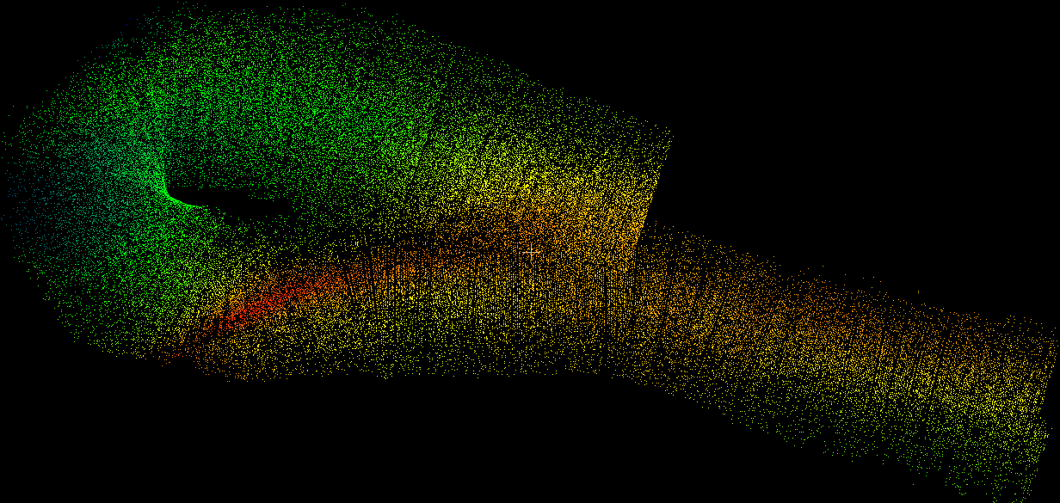
Random
20%

Slide 58
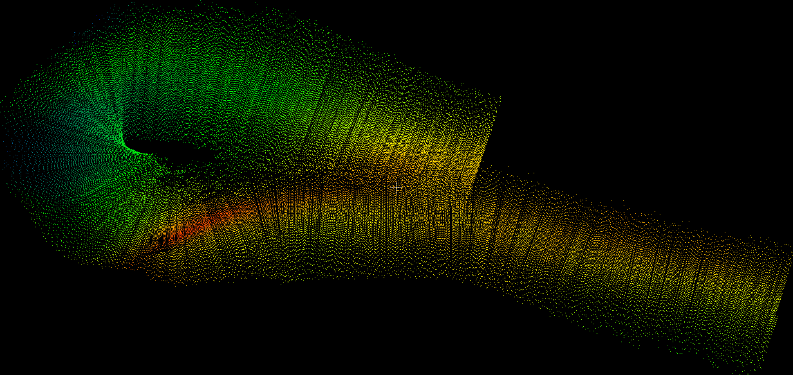
Systematic
every 5th pt
20%

Slide 59
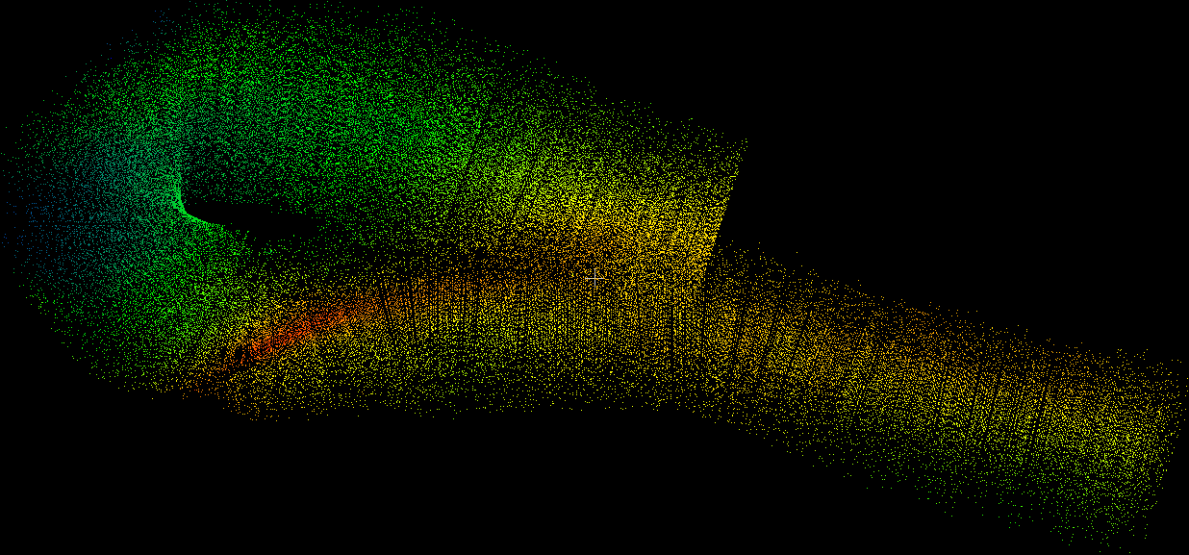
Hybrid
20%

Slide 60
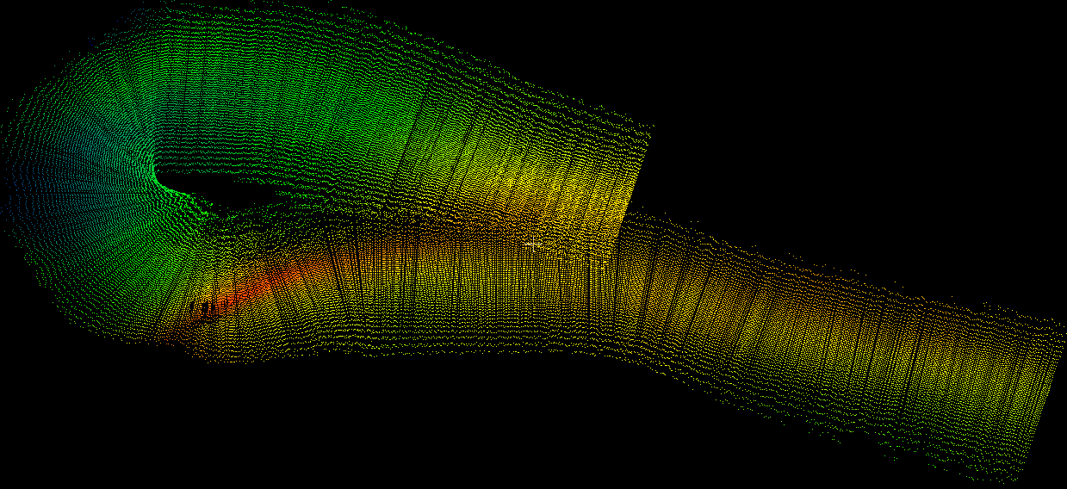
Average
20%

Slide 61
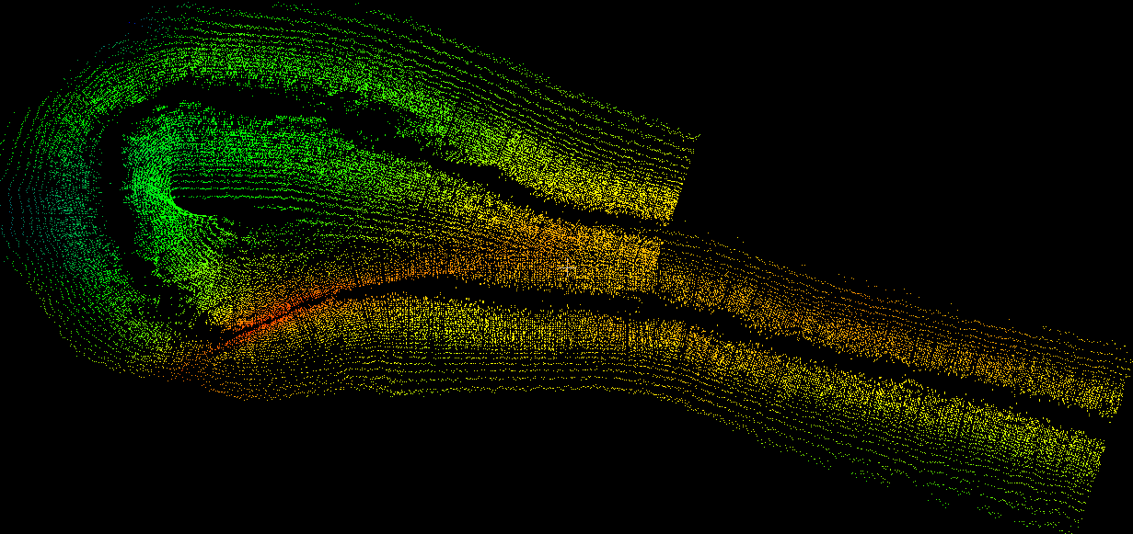
Dissimilar Neighbor
20%

Slide 62

Dissimilar Neighbor
20%
$d_{r}=$ $\frac{min(d_{i+1}, d_{i−1})}{max(d_{i+1}, d_{i−1})}$

Slide 63

Kmeans
20%

Slide 64
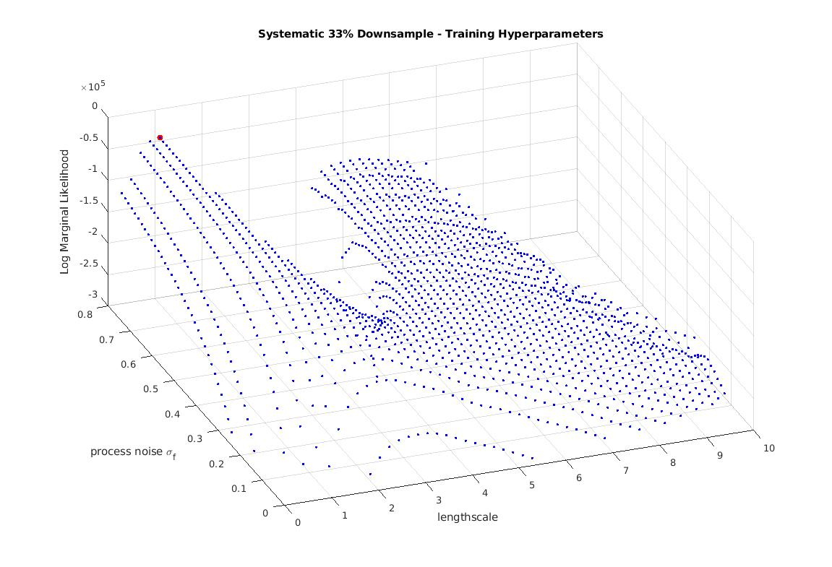
Training Hyperparameters
Maximize LML Plot
Log Marginal Likelihood (LML) maximization
LML
reward fit
punish complexity
normalize
process noise
lengthscale

Slide 65
Training Hyperparameters
Maximize LML Plot
Log Marginal Likelihood (LML) maximization
LML
bad solution zone!
bad solution zone!
The ‘max’ is dangerous
Choose a more reasonable pt
process noise
lengthscale

Slide 66
What about the hyperparams?
GPR model
pre-trained
live data
(pings)
prediction
tiles

Slide 67
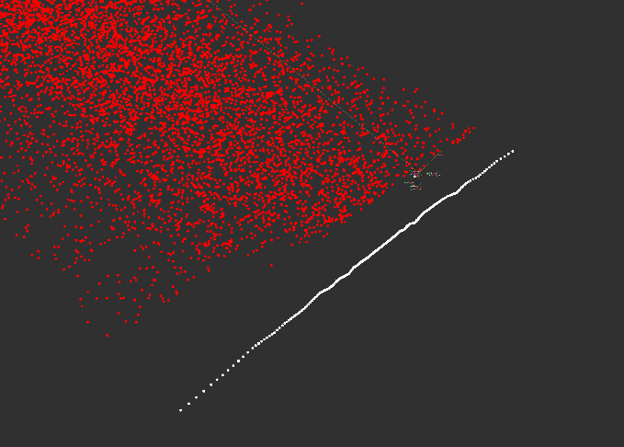
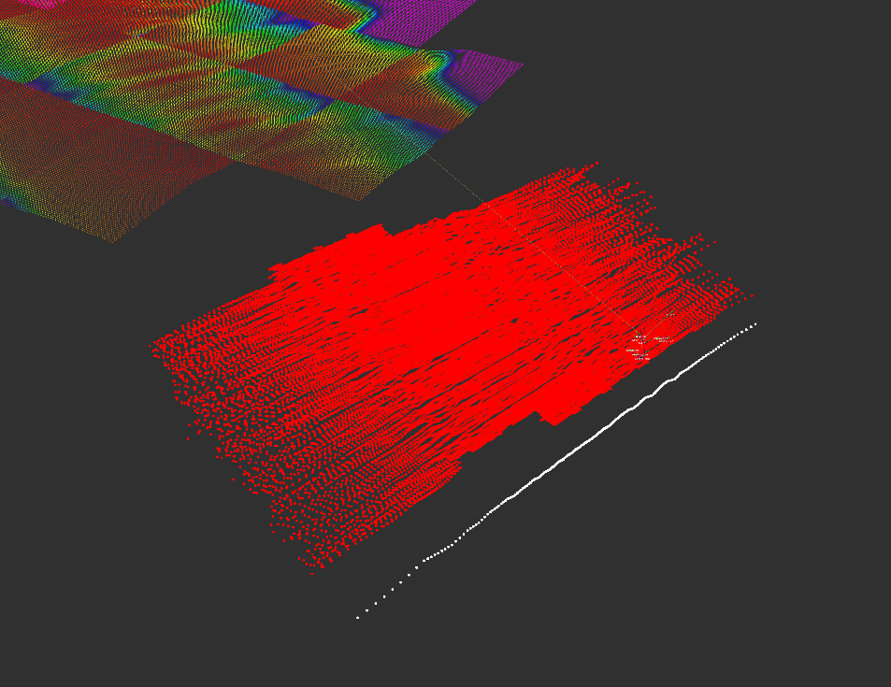
What about the hyperparams?
GPR model
pre-trained
downsampled
pings
prediction
tiles

Slide 68
What about the hyperparams?
GPR model
pre-trained

Slide 69
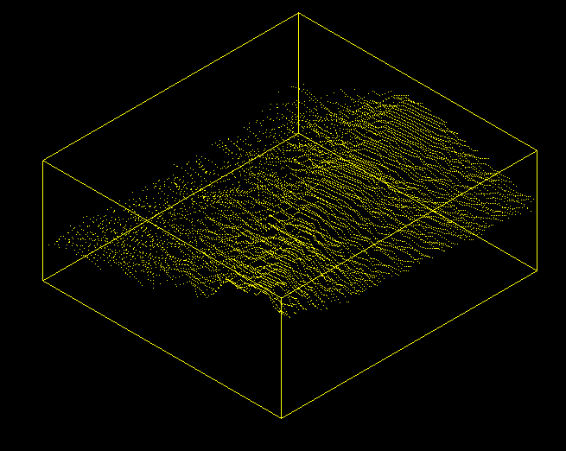
What about the hyperparams?
Train our
params
first!
w/
GPR model
pre-trained

Slide 70
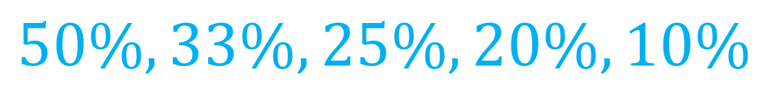

Running Trials
Percent of Points KEPT
Random, Hybrid, Neighbor, K-means
$$90\%, 80\%, …, 10\%$$
Systematic, Average
$$50\%, 33\%, 25\%,20\%,10\%$$

Slide 71
Running Trials
for each method {random, kmeans, ...}
for each downsample percent {90%, 80%, …}
1.) downsample swath
2.) train hyperparams on mini-patch
3.) run live
4.) post-processing to get stats
end
end

Slide 72
Running Trials
for each method {random, kmeans, ...}
for each downsample percent {90%, 80%, …}
1.) downsample swath
2.) train hyperparams on mini-patch
3.) run live
4.) post-processing to get stats
end
end

Slide 73
Running Trials
Exact Map (100%)
Approx Map (20% random)

Slide 74
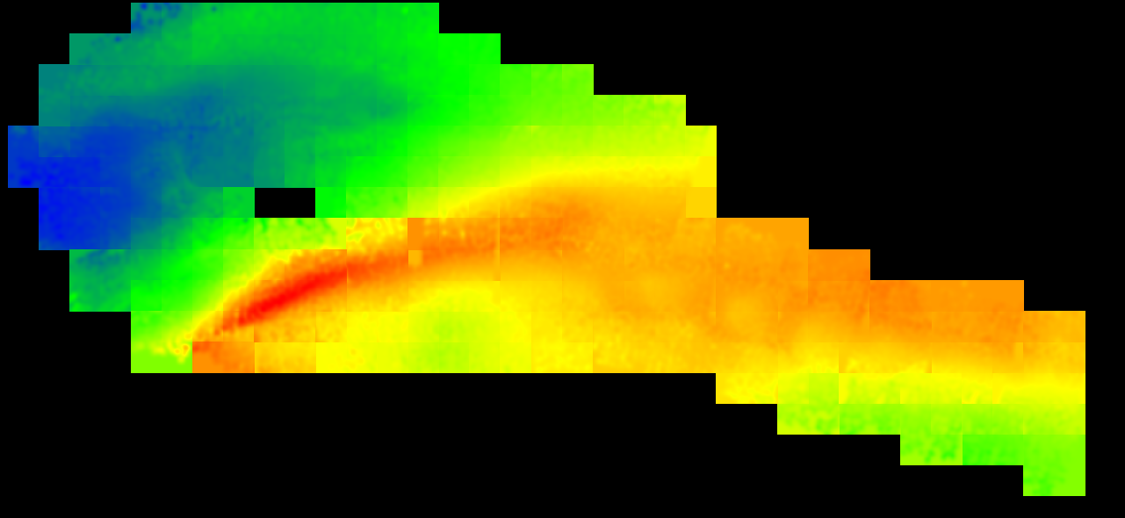
Running Trials
Exact Map (100%)
Approx Map (20% random)
92secs
20secs

Slide 75
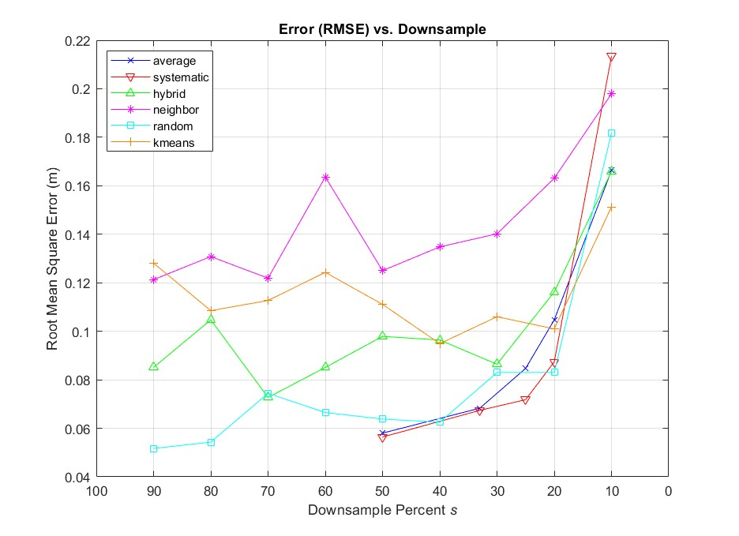
Results

Slide 76
Results

Slide 77
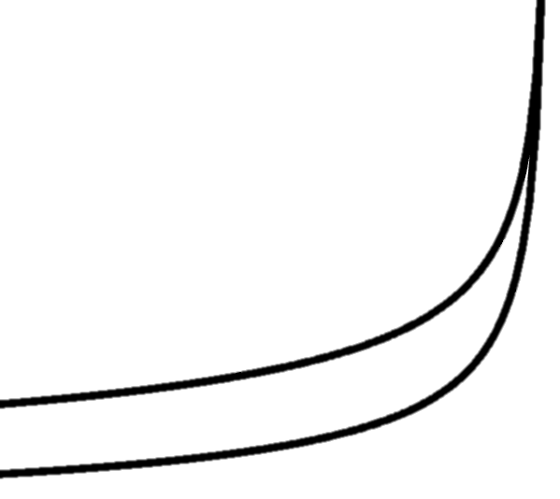


Results
$$y=\frac{1}{\sqrt[3]{s}}$$
$$y=\frac{1}{\sqrt{s}}$$

Slide 78
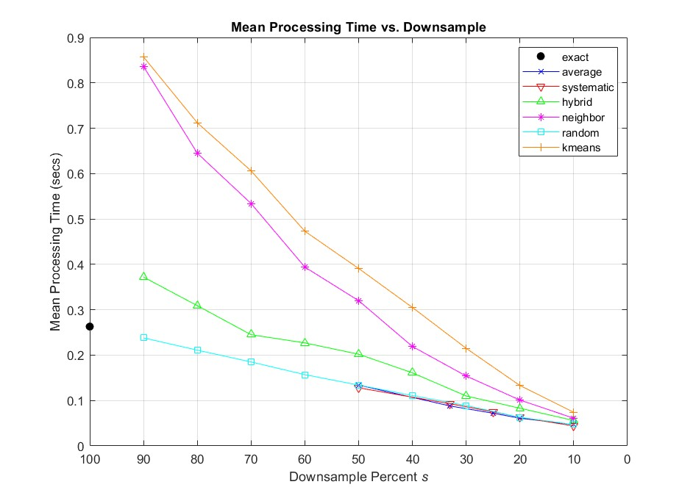
Results

Slide 79
Results
$$time≈constant∙s$$

Slide 80
Results
$$time≈constant∙s$$

Slide 81
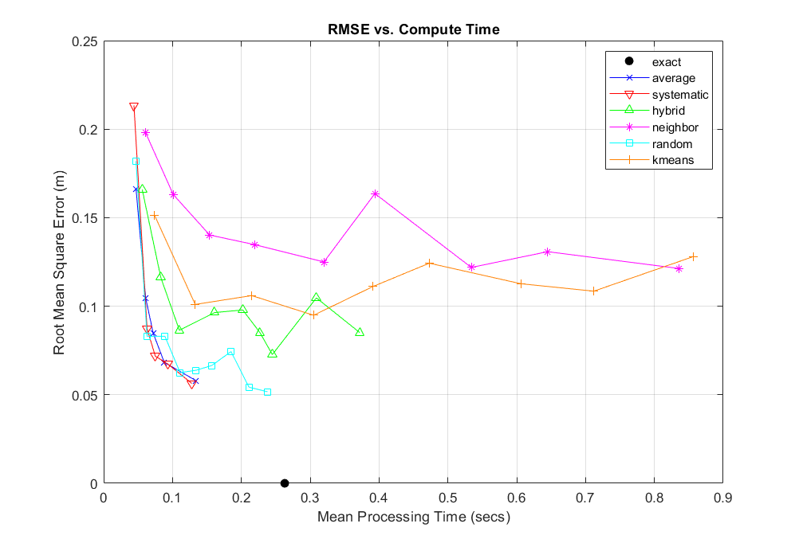
fast + inaccurate
slow + inaccurate
fast + accurate
slow + accurate

Slide 82

Conclusions
Compute time scales linearly
Accuracy scales $1/\sqrt[c]{n}$
You can remove 2/3 of your data and be OK
‘Fancy’ methods were not worth it
Big gains nearby

Slide 83

Acknowledgements
Chris Roman, Mingxi Zhou, Peter Swaszek
Kris Krasnosky & Roman Labmates
Friends & family
Office of Naval Research
Karl Rasmussen + many YouTubers

Slide 84
Thank you

Slide 85
Computation Time
Total Time = Downsample Time + Inference Time + overhead
Random
cheap
Systematic
cheap
should be same…
Hybrid
½ random + ½ systematic
same
sparsity / efficiency altered?
Average
N*s-calcs
Neighbor
3N-calcs
Random, then 15 iterations of N calcs
K-means

Slide 86
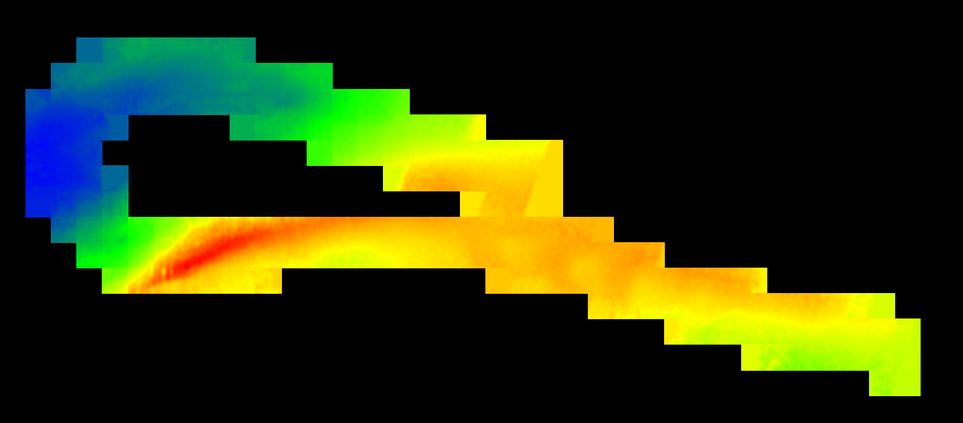
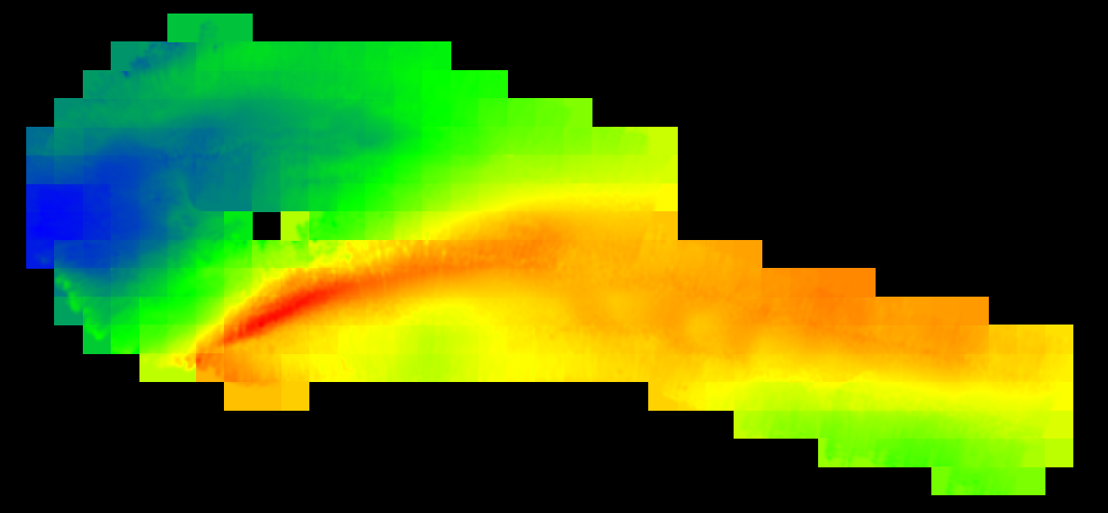


What’s happening to our tiles?
Kmeans 50% inference tiles
Systematic 50% inference tiles
Neighbor 50% inference tiles
Random 10% inference tiles

Slide 87






Maybe it’s in the blocks…
Systematic 50% blocks
Kmeans 50% blocks
Average 50% bocks
Neighbor 50% blocks
Hybrid 50% bocks
Random 50% blocks

Slide 88





Slide 89



swath
ping
inference tile

Slide 90



Slide 91


CTD Cast
refraction negligible!

Slide 92


GPR Equations

Slide 93


Log Marginal Likelihood

Slide 94


Slide 95


Slide 96


Slide 97


Slide 98


Slide 99


Slide 100


Slide 101


Slide 102


